Slide 1
ECHT Training Workshop 1
PUMA Case Sharing

Slide 2
What does Traceability Mean for PUMA?

Slide 3











Overview of A Traceability framework
Step 1:
Supply chain mapping
SUPPLIER DETAIL
Identify the suppliers from the beginning to the end
Step 2:
DATA
To build the chain of custody
WHAT is the object being traced
WHO are involved
WHERE did the process take
WHEN did the process occur
WHY the process take place
Additional information
traceability
Link material & chemical inventory with product
Product segregation
Information by production batch
Step 3:
VERIFICATION & Validation
Due diligence on data accuracy & integrity
Step 4:
Information Sharing
Sharing information to downstream user

Slide 4













How the information flows
Upstream
Downstream
Farm
Bale
Retail
Yarn
Fabric
Garment
Chemical
Chips
Consumer
Digital Information
Recycled Material
End-of-Life / Recycler

Slide 5



Supply Chain MAP
Material & Chemical flow
Collect supplier, facility, process detail
Data flow

Slide 6
Data Required
General Data Requirement
Input
Production
Input lot number
Output
Input lot number
Production lot number
Input quantity
Input date
Seller name
Input quantity
Production date
Production lot number
Output quantity
Output quantity
Output date
Invoice number
Input chemical
Invoice number
Chemical Info.

Slide 7

Link data with product
Supplier Data
Supplier Name
Process Data
Product Data
SKU
Purchase Order Data
Supplier Location
Facility Name
Facility Location
Purchase Order
BOM
Season
Material Input
Chemical Input
Subcontractor
Material Output
Destination

Slide 8
How to start the chemical Traceability Journey

Slide 9




End-goal of
Traceability Exercise
Report Substances of Concern (SoC) on Product
Step-by-step Process
Develop Process
Formulate & Define
Goals & Objectives
Standard Procedure
Tools
…
Data Collection
Screening against SoC
Reporting
Tools, e.g. Platform for Data Collection & Display
Internal Platform
External Service Provider
Key Priorities

Slide 10
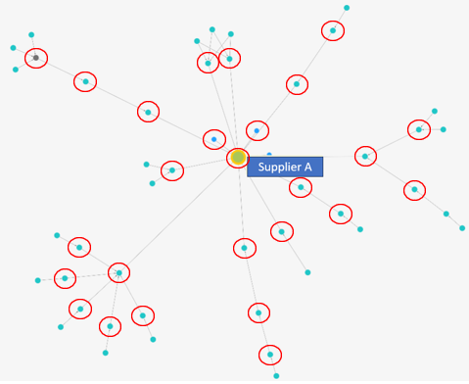
Create a Supply Chain Map
Identify Suppliers with Chemical Process
Understand your supply Chain
Prioritize Suppliers
Identify suppliers with chemical process
Direct Suppliers
Indirect Suppliers & Subcontractors
Agents & Traders
…

Slide 11
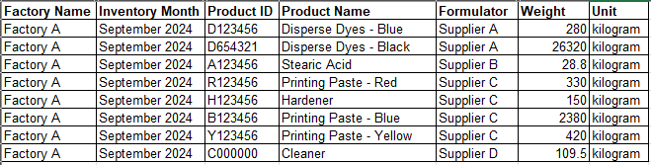

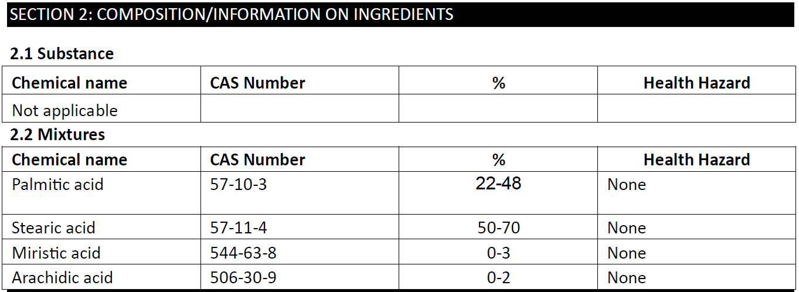
Factory Chemical Inventory
Identify information required
Collect SDS & Extract Data
Specify the needs
Chemical Inventory List (CIL)
Chemical Safety Data Sheet (SDS)
Process Information
Input, Production & Output Data
…
Production Process &
Chem. Use
Mix Printing Paste – 2.5 kg
Printing Paste Red – 1 kg
Screen Printing – 100 Units
Frame Cleaning
Cleaner – 1kg
Printing Paste Yellow – 0.5 kg
Hardener – 0.1 kg
-

Slide 12



Stakeholder Meeting
Training
Communication
Communicate with stakeholders
Stakeholder Feedback
Inform stakeholders & ask for feedback
Suppler & Information Readiness
Missing Info. & Challenges
Resources – e.g. Digital tools, Manpower
…
Readiness Check
Challenges & Difficulties
Support
Helpdesk
Resources

Slide 13



Document Checking
Verification & Validation
Data Accuracy Check
Supporting Documents
Data accuracy & Integrity
Desktop Review
Onsite Visit
Due Diligence
…
Factory Visit
Chemical Warehouse
Chemical Management

Slide 14
Key Challenges For PUMA

Slide 15
Incomplete Supply Chain Visibility
Complex Manufacturing Process (Chemical)
Indirect Supplier Relationship
Intensive Data Requirement
Unavailability of Information
Heavy Manual Work
Low Level of Digitalization of Supplier
Incompatibility on Data Exchange
Investment

Slide 16

Know your supply Chain
Know your Product
Pass the information
Supply Chain Map
Production & Transaction Data
Manufacturing Process
Material Composition
Chemical Usage
Substantiation Documents
Pass Verified Data Along Value Chain
Resources Required
Communication & Feedback

